Slide 1
Decision Trees: Assignment-2
Jigsaw user Id: veeranna.mh@gmail.com

Slide 2
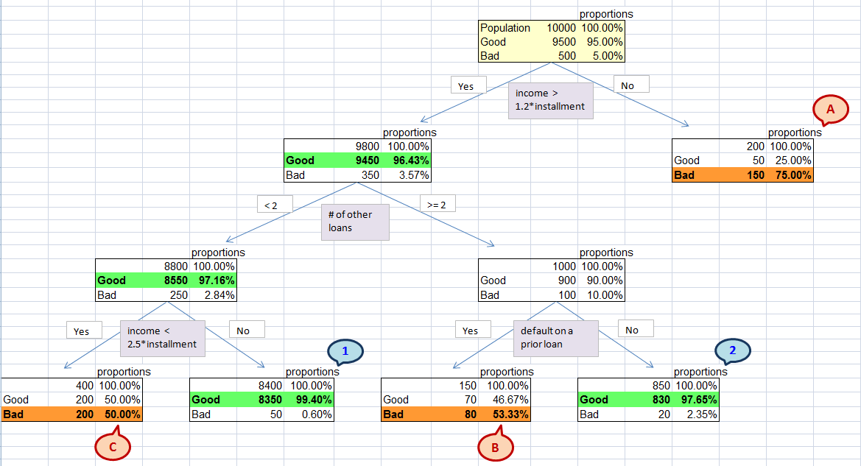
Decision Trees: Assignment-2
Recommendation:
Group 1 and Group 2 with proportions of good 99.4% and 97.65% respectively shall be targeted as potential customers. Group 1 is a large customer base with 83.5 % of original population, where as Group 2 is around 8.3 % of original population and hence business risk is less.
Groups A, B and C with proportion of bad (defaulters) 75%, 53.33% and 50% respectively shall be avoided to reduce default cases.
If bank has aggressive marketing strategies, Group C can be considered with suitable measures.

Slide 3
Decision Trees: Assignment-2
Groups:
Group 1: (income > 1.2 * installment) & (# of other loans < 2) & (income !< 2.5 * installment)
Group 2: (income > 1.2 * installment) & (# of other loans >= 2) & (NO default on prior loan)
Group A: (income !> 1.2 * installment)
Group B: (income > 1.2 * installment) & (# of other loans >= 2) & (default on prior loan)
Group C: (income > 1.2 * installment) & (# of other loans < 2) & (income < 2.5 * installment)

